Slide 1

Abnormality Detection and Segmentation in Musculoskeletal Radiographs
ECE 9309 Team Project
Instructor: Dr. Fadi Almahammad
Presenters: Amina Tabassum, Xiang Li, Thisali
April 4ᵗʰ, 2025
Notes:
<number>

Slide 2

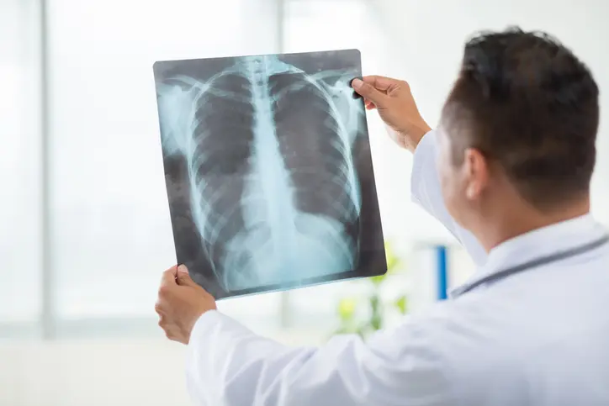

Introduction
2
Musculoskeletal disorders (MSDs) such as fractures, arthritis, and joint deformities affect millions worldwide.
Diagnosing these disorders requires accurate interpretation of X-ray images, which is a time-consuming and error-prone process.
Manual diagnosis by radiologists can be subjective, leading to missed diagnoses or delayed treatment.
Notes:
MSD – affect joints, bones, muscles, and adjacent connective tissue
While treatment and rehabilitation is key, identifying methods to prevent injury is crucial to reducing the burden of MSD
<number>

Slide 3

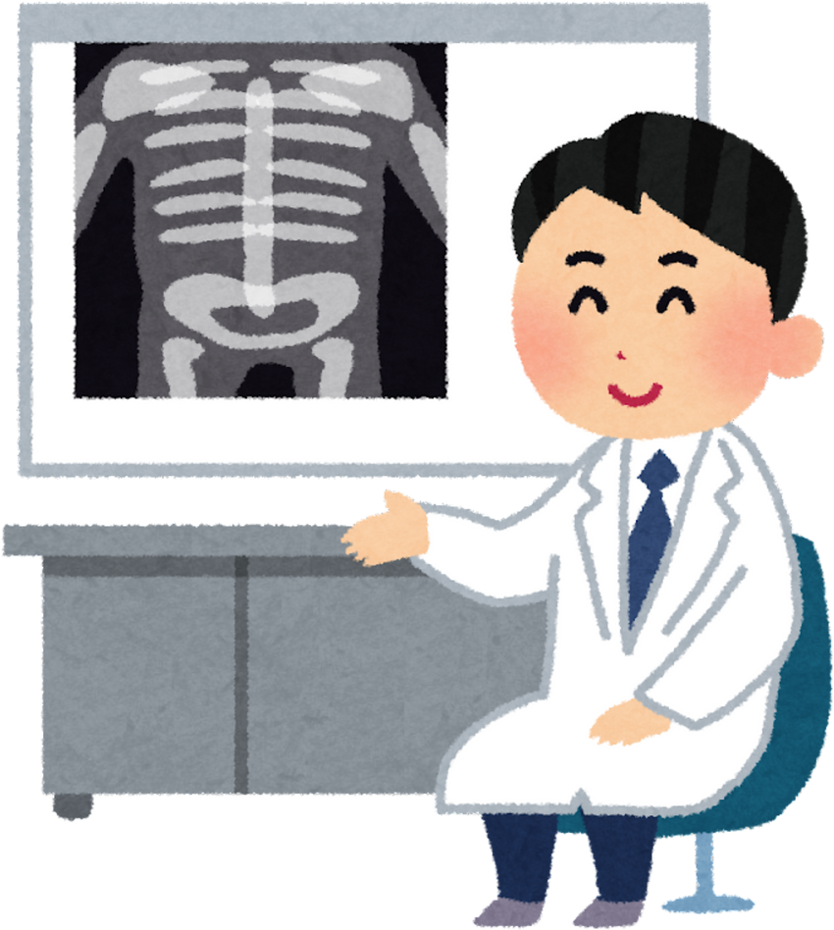
Problem Statement
3
Objectives
Lack of reliable and transparent automated systems that can assist in accurate classification and localization of abnormalities in musculoskeletal X-ray images.
CLASSIFYING XRAY IMAGE AS NORMAL OR ABNORMAL
Identify a given X- RAY image abnormal or normal automatically using a deep learning method.
IDENTIFY WHERE THE ABNORMALITY IS
Segment the X-ray image image and identify where the abnormality is inoder to increase the reliablity.

Slide 4
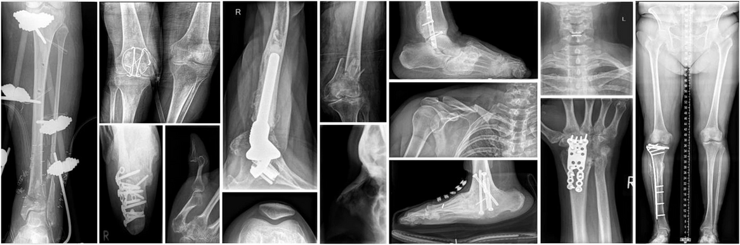
Musculoskeletal Radiographs (MURA) Dataset
4
40,561 Musculoskeletal (MSK) radiographic images from 14,863 studies across 7 MSK extremities (elbow, finger, forearm, hand, humerus, shoulder, wrist).
Each study is labeled as normal or abnormal by radiologists.
Additional labels from six board certifies radiologists were collected on 207 studies for the test set.
Data Pre-Processing
Image size : For both ResNet and EfficientNet models, the input images are resized to 224x224 pixels.
Normalization : The image pixel values are normalized to the range [0, 1]
Normalize([0.485, 0.456, 0.406], [0.229, 0.224, 0.225])
Notes:
Here is a flowchart of the data collection process. Each of the 34 participants gets some anthropometric Measurements done and does a warm-up. Then our EMG and IMU sensors are placed on the upper body, there are 6 each. We wont worry about KSS, or PPG. Then the participants perform an external and internal should rotation at their maximum capacity, this is called MVIC and is used for normalization in later steps. Then the exercises are performed. Internal and external shoulder rotation at 3 levels of intensity (varying percentages of MVIC) for a total of 6 exercises per subject. They report their fatigue level every 10 seconds, using the Borg scale, and the exercise is completed when they reach maximum fatigue.
This is an overview of the data we are working with. The important information here is that each of the 34 healthy participants has some anthropometric measurements done. Each person perform Shoulder Internal Rotation and External rotation at three levels of intensity each. The intensity if based off a percentage of their maximum force. They report their fatigue level every 10 seconds, using the Borg scale, and the exercise is completed when they reach maximum fatigue. 6 IMU and EMG sensors are used to collect signals from the upper body.
<number>

Slide 5
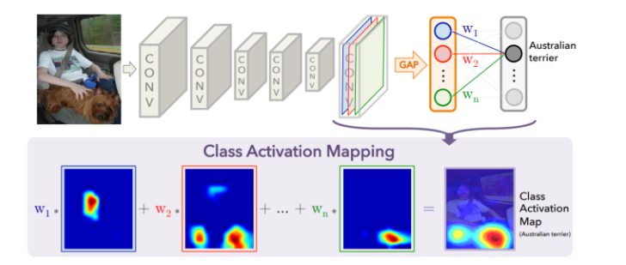
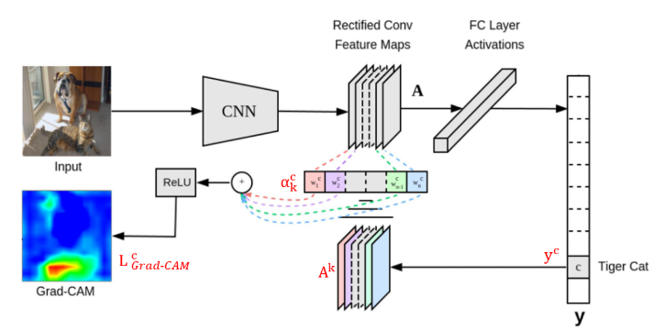
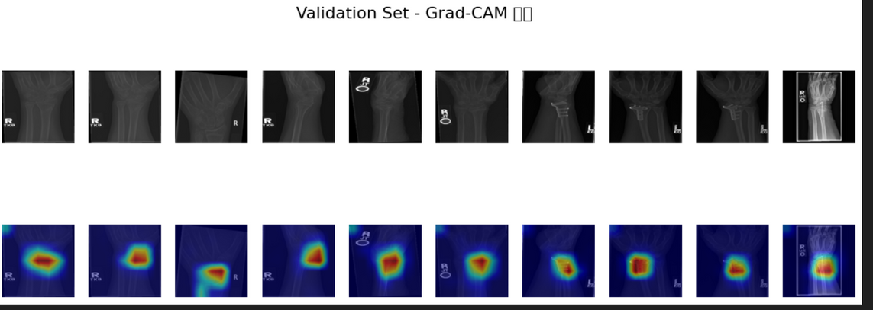
Class Activation Maps (CAM)
5
CAM
Grad-CAM
Used to visualize areas in the image relevant to the model’s decision.
The core of CAM is GAP (global average pooling layer)
Limitations for CAM：
Need to Train whole model
Cannot use pretrain model
The fully connected layer is directly connected.
The gradients of the last convolutional layer’s feature maps is calculated.

Slide 6
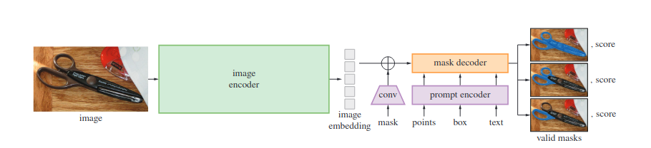
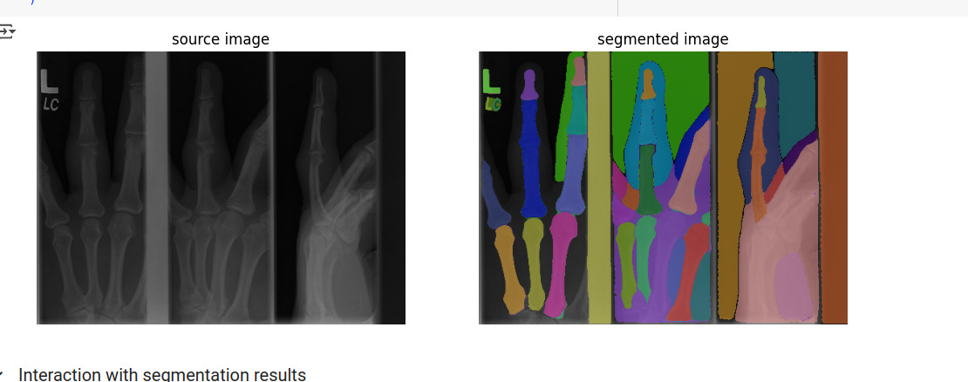
Segment Anything Model (SAM)
6
Bounding box (Output of Grad-CAM) is used to prompt segmentation mask.
Based on the prompts and image embeddings, segmentation mask is generated.

Slide 7
Overall Architecture
7

Slide 8
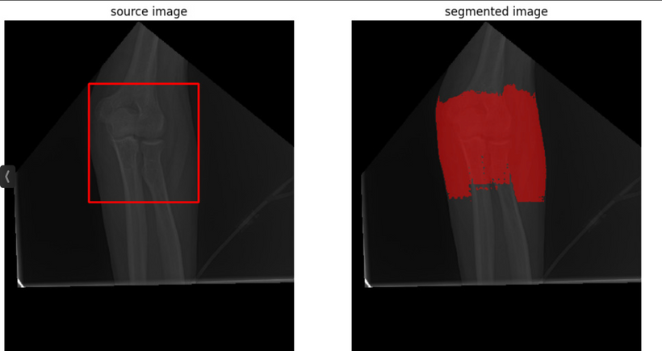
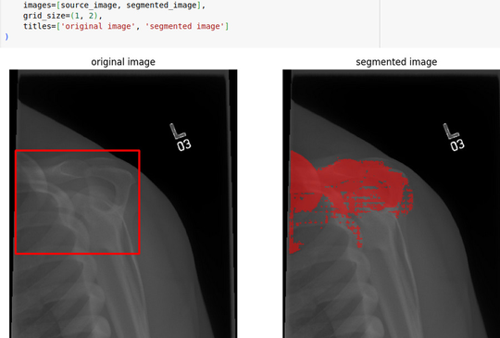
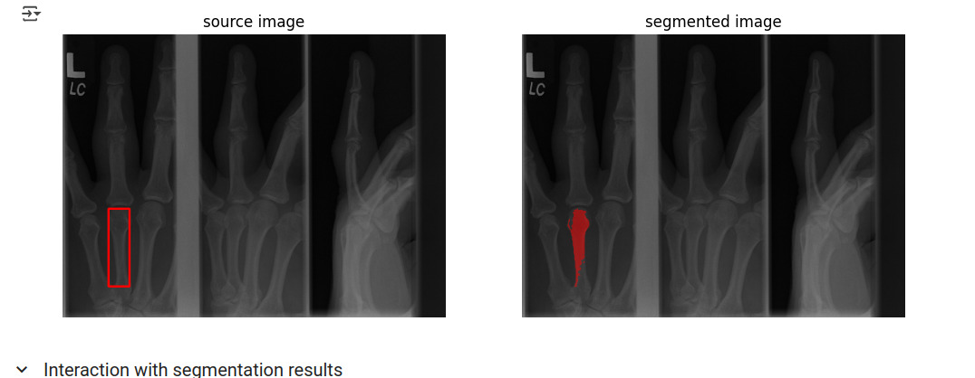
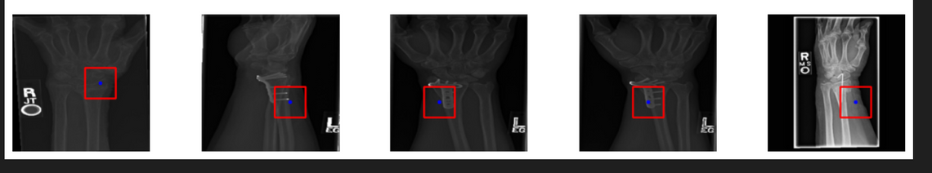
Results
8
Notes:
<number>

Slide 9
Discussion
9
Classification accuracy of 95.92 %
Class activation maps are used to generate bounding boxes
Weak supervised segmentation is used
Segment anything model gives dice score coefficient value of 0.89
The classification accuracy and the CNN model can be improved, so that the CAM model may focus more on the anomaly area.
Currently, the accuracy of SAM segmenting the bounding box area is low. We can learn and modify the SAM model to increase the segmentation accuracy.

Slide 10
10
Conclusion
Weak supervised segmentation for medical image segmentation
Class activation masks can be used to generate bounding boxes
Zero shot generalization of Segment Anything Model
Bounding box based prompt segmentation gives 89% accuracy

Slide 11
References
11
[1] L. M. Waddell et al., “Responsiveness of subjective and objective measures of pain and function following operative interventions for musculoskeletal conditions: A narrative review,” Arthritis care & research,
vol. 76, no. 6, pp. 882–888, 2024.
[2] J. D. Howell, “EARLY CLINICAL USE OF THE X-RAY,” Transactions of the American Clinical and Climatological Association, vol. 127,pp. 341–349, 2016.
[3] L. C. Lawrence, Machine Learning Integration in Healthcare: Human Error Reduction in Breast Cancer Screening. PhD thesis, 2024. Copyright - Database copyright ProQuest LLC; ProQuest does not claim
copyright in the individual underlying works; Last updated - 2024-07-11.
[4] N. M. Pillai, S. Manimala, A. S. Rongali, A. Gugnani, A. S. Kumar, and G. V. Sriramakrishnan, “Automated classification of medical images using convolutional neural networks,” 2024 15th International Conference
on Computing Communication and Networking Technologies (ICCCNT),pp. 1–6, 2024.

Slide 12
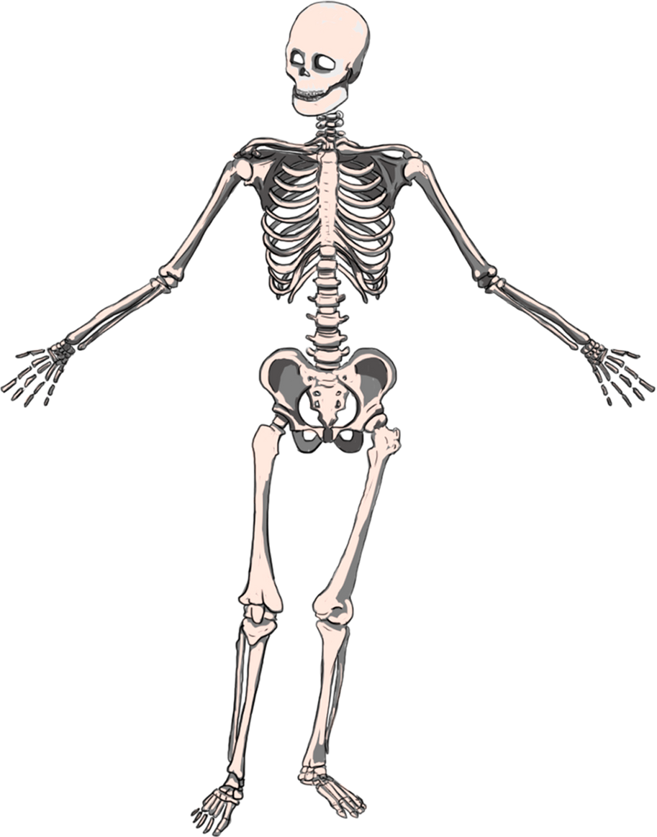
Questions?
Notes:
IMU and EMG can estimate muscle fatigue
Otalro et al. EMG is considered gold-standard method to estimate MF – It directly assesses bio-electrical muscle function
Bangaru et al used EMG and IMU to predict muscle fatigue for construction applications. They found that decision tree classifier had the best accuracy
What models work for fatigue estimation
Kankaanpae Ae M et al. Borg value is well accepted for measuring subjective estimates of fatigue in a ragne of exertion studies
Un-analysed Dataset (WSD4FEDSRM) created in 2023 exists which has sensor data for participants performing repetitive loaded should exercises and self-reporting fatigue level.
<number>

Slide 13
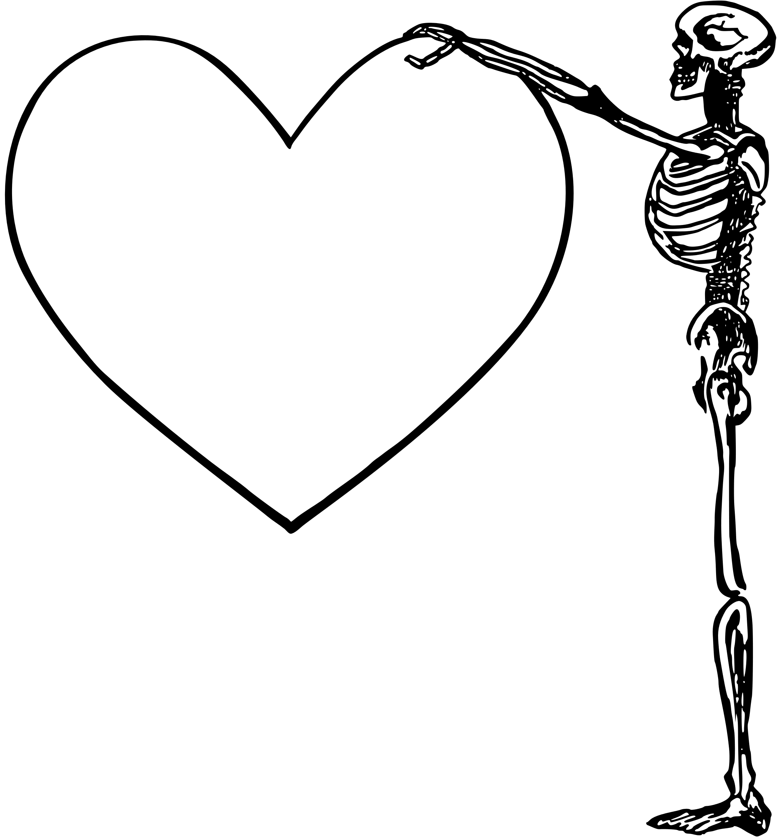
Thank You
Notes:
IMU and EMG can estimate muscle fatigue
Otalro et al. EMG is considered gold-standard method to estimate MF – It directly assesses bio-electrical muscle function
Bangaru et al used EMG and IMU to predict muscle fatigue for construction applications. They found that decision tree classifier had the best accuracy
What models work for fatigue estimation
Kankaanpae Ae M et al. Borg value is well accepted for measuring subjective estimates of fatigue in a ragne of exertion studies
Un-analysed Dataset (WSD4FEDSRM) created in 2023 exists which has sensor data for participants performing repetitive loaded should exercises and self-reporting fatigue level.
<number>

